Slide 1

"Guardians of the Edge: Enhancing Security for DNN Deployments"
Reema Dass

Slide 2
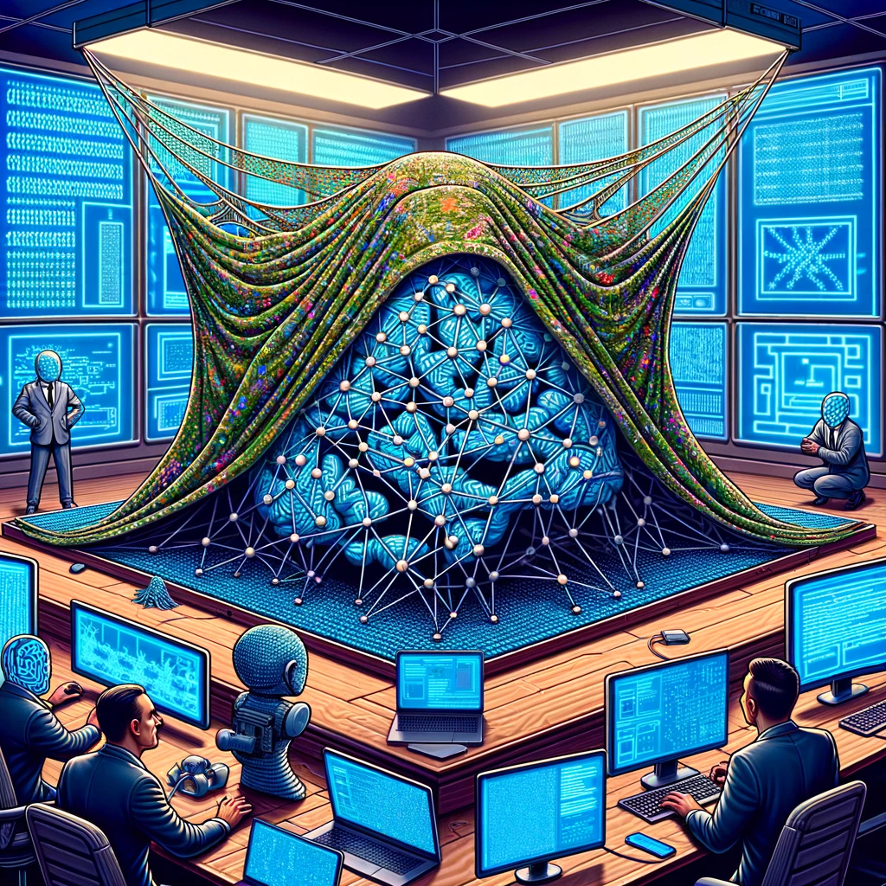
Topics Covered:
Agenda
What is Obfuscation?
How can Obfuscation help with security?
Main Research in focus
Insights of this implementation
What more can be done?

Slide 3
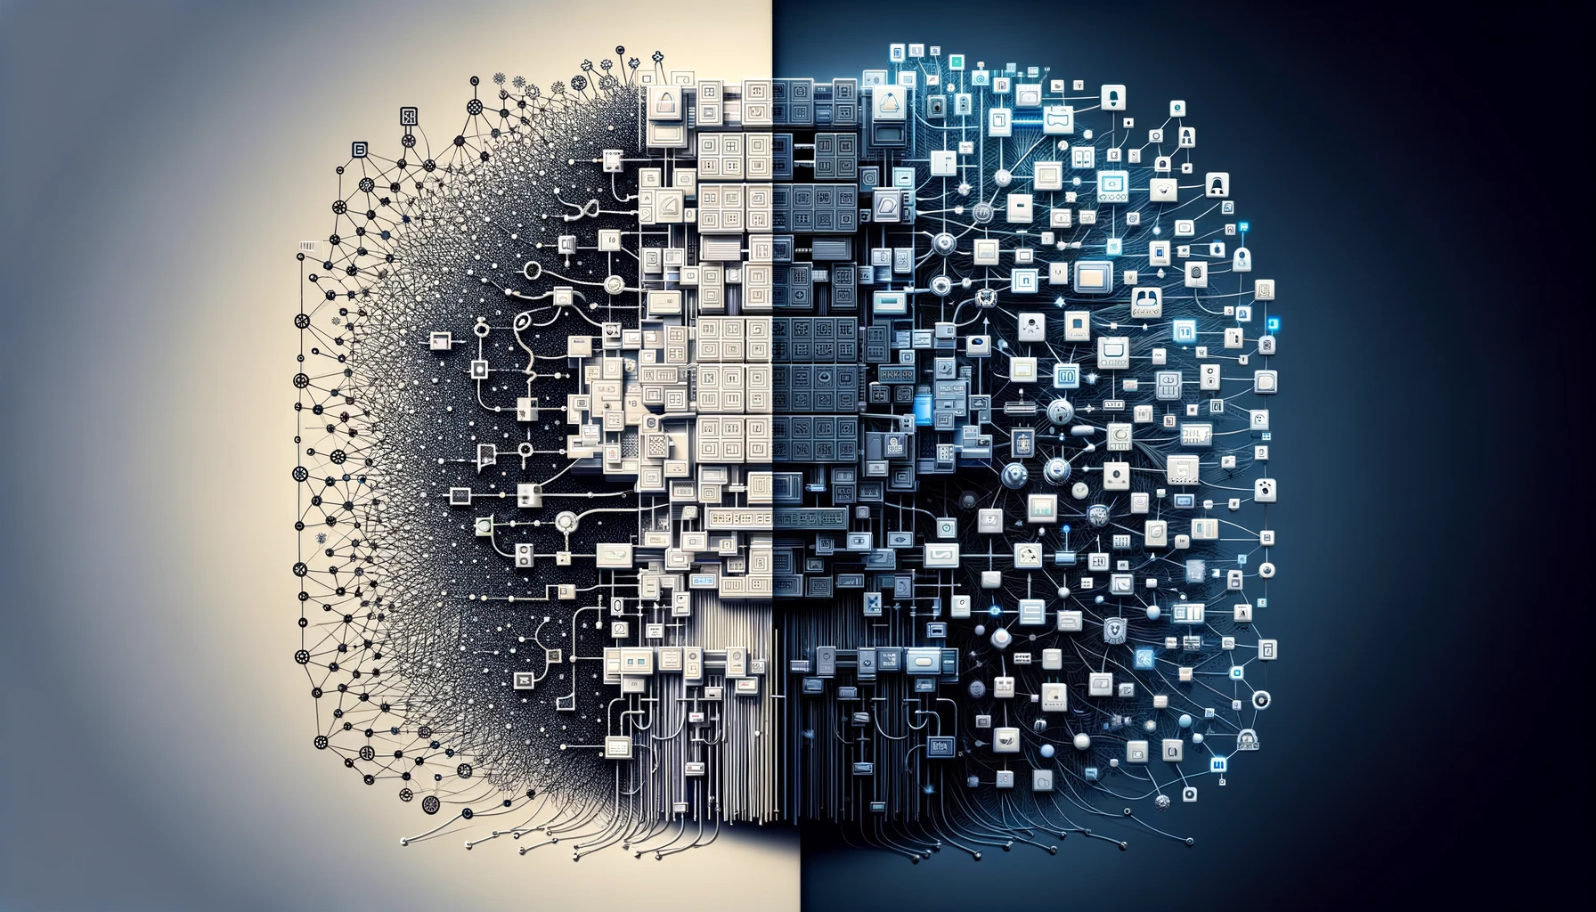

Definition!
The action of making something
obscure, unclear.
Well, In simpler words !
It's the tech version of playing peekaboo.
Neural network obfuscation is like giving your computer's brain a secret handshake and a disguise, then telling it to act natural.

Slide 4
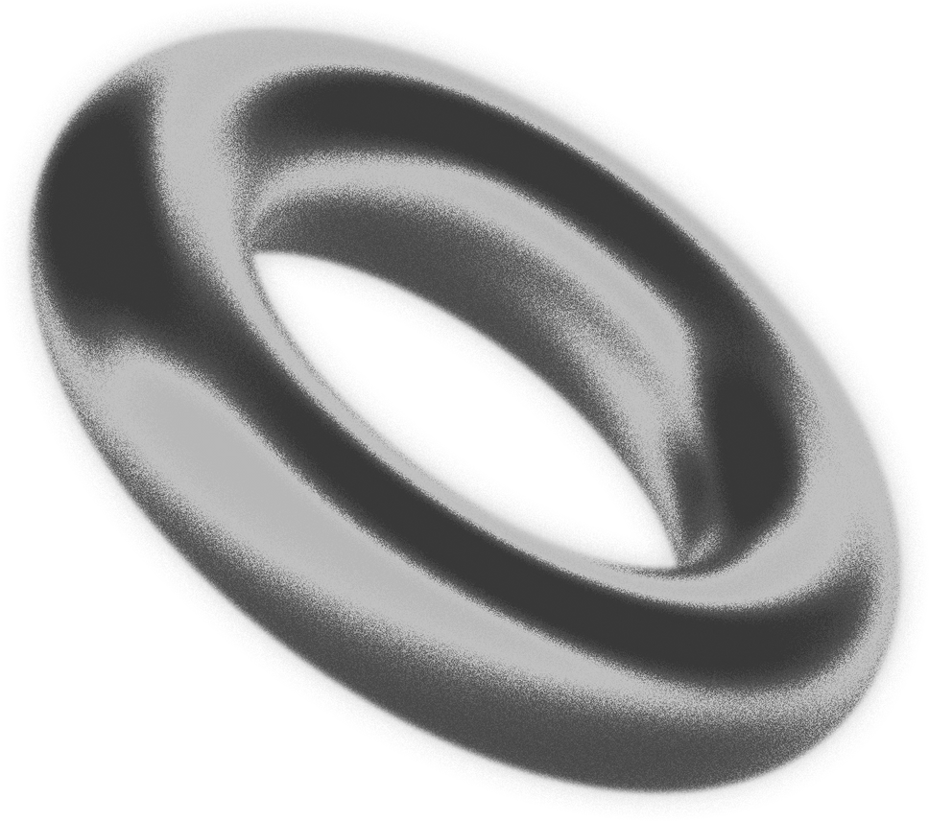
Obfuscation and its Security Contributions.
Enhance Confidentiality
Simpler to adapt in Edge models
Complexifies Reverse Engineering (debatable)
Discourages Intellectual Property Misuse
Enhanced Security Against some Adversarial Attacks
Evasion attack (change models decision making)
Boundry attacks
In general, makes attacks difficult
Tflite.

Slide 5

ModelObfuscator: Obfuscating Model Information to Protect Deployed ML-based Systems

Slide 6
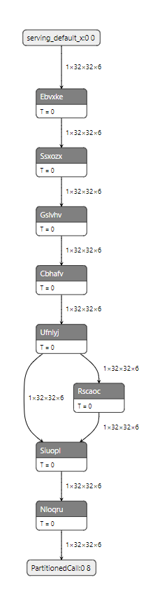
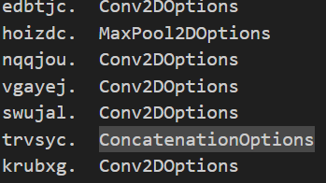
Idea:
Extra layer injection and Shortcut injection
Obfuscation of DNN models deployed in edge devices in the following ways:
Parameter Encapsulation
Renaming
Shortcut injection
Extra layer injection
Renaming:

Slide 7
Visualizing the Architectural differences and analyzing
Visualize !

Slide 8
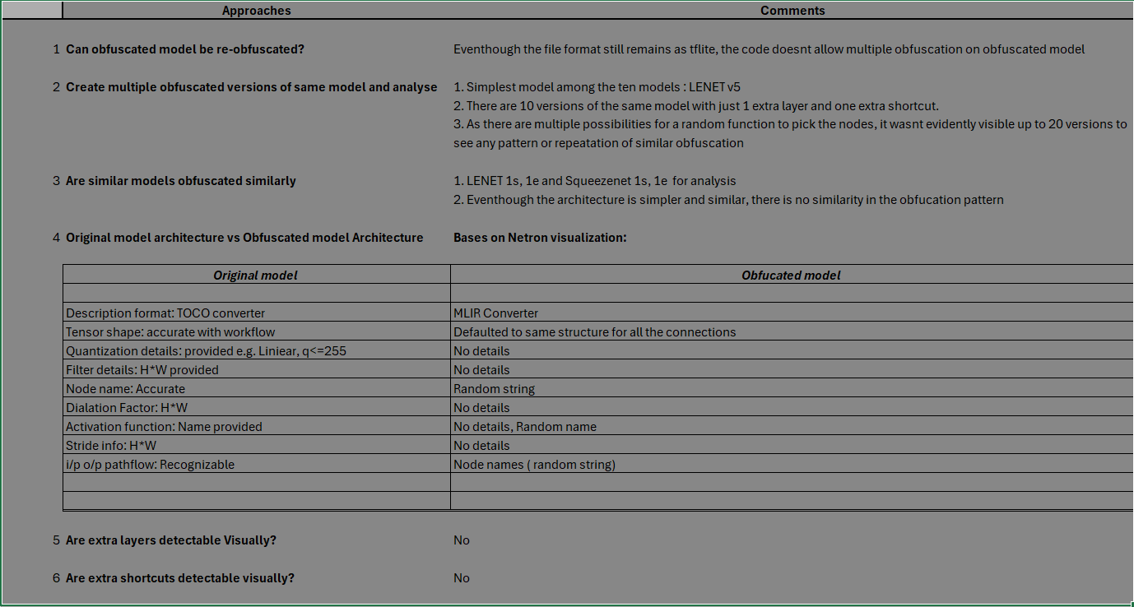
Analysis:

Slide 9
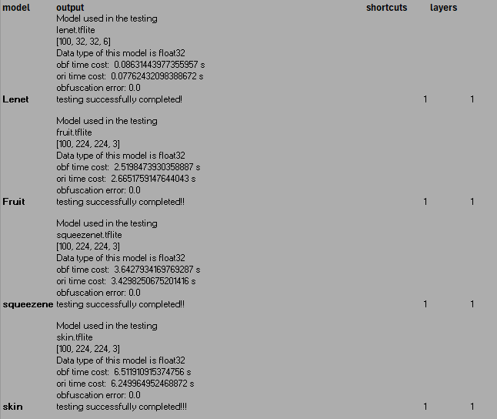
Finally, Some numbers!

Slide 10
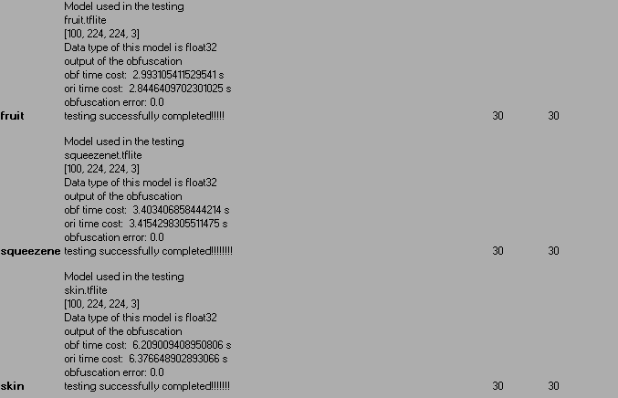
Finally, Some numbers, Part2

Slide 11
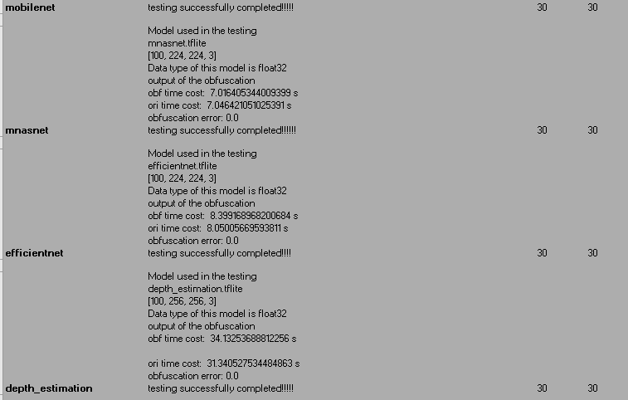
Finally, Some numbers, End Game.

Slide 12

What next?

Slide 13
Questions to be answered wrt. the current paper!
Where the parameters are stored?
Can I combine this information with architecture file and yield a better visualization of model architecture?
Steps involved to exclude extra layer and shortcut implementation
How well are the custom operators obfuscated?
How can this approach be made better than its current state?
Initial Plan:
Testing it against Neuro obfuscator, a paper that claims to de-obfuscate any kind of obfuscated model.
Explore if this approach can work on the obfuscated model.
Analyze the results( the scope could change):
If it can de-obfuscate, how can it be prevented.
If it cant de-obfuscate, explore the reasons.

Slide 14
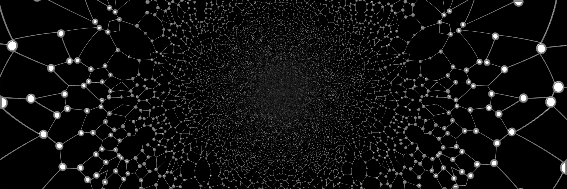
Well,
Its done.
Any suggestions?,
inputs or
thoughts?????

Slide 15
Thank you!

Slide 16

Any questions?

Slide 17
Now I am really done ☺
Thank you!

Slide 18
Tf vs Tf lite model
Primarily centers around the transition from a model designed for training to one optimized for inference.
During conversion of the TF model to TF-lite model:
Graph Transformation and Optimization.
Pruning
Optimizations (quantization , operator fusion)
Removal of Training Operations (graph modifications)
Intentions behind it:
Reduced model size
Execution speed
Inference only capabilities
Defence against attacks

Slide 19
Then why have it as a part of TF models?
Unified Model Architecture
Flexibility for Further Training
Advanced Inference Features
Debugging and Analysis

